Slide 1
CRYPTOGRAPHY
Classical Cryptography

Slide 2
Classical Cryptosystems (Polyalphabetic)

Slide 3
Polyalphabetic Ciphers
The simple substitution cipher is weak because the attacker can exploit the fact that:
  The letter frequency distribution of the ciphertext will match the letter frequency distribution of the plaintext
  These will generally follow the letter frequency distribution of the plaintext language
A simple way to defeat frequency analysis is to encipher each plaintext letter with a different substitution alphabet
The use of multiple substitution alphabets will mean that a plaintext letter can encrypt to different ciphertext letters, thus causing the letter frequency distribution to appear “flatter” (the individual letter frequencies are averaged out)
A cipher that uses multiple substitution alphabets is called a polyalphabetic substitution cipher. The Vigenere Cipher and Hill Cipher are examples of alphabetic ciphers

Slide 4
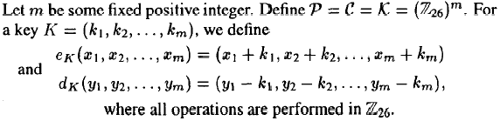
1. The Viginere Cipher
Suppose key length (m)=6
Key word (K) = C I P H E R = (2,8,15,7,4,17)
Plaintext (P) = thiscryptosystemisnotsecure
Possible keys= 26^{m}
P | t | h | i | s | c | r |  | y | p | t | o | s | y
 | 19 | 7 | 8 | 18 | 2 | 17 |  | 24 | 15 | 19 | 14 | 18 | 24
K | 2 | 8 | 15 | 7 | 4 | 17 |  | 2 | 8 | 15 | 7 | 4 | 17
 | 21 | 15 | 23 | 25 | 6 | 8 |  | 0 | 23 | 8 | 21 | 22 | 15
C | V | P | X | Z | G | I |  | A | X | I | V | W | P
P | s | t | e | m | i | s |  | n | o | t | s | e | c
 | 18 | 19 | 4 | 12 | 8 | 18 |  | 13 | 14 | 19 | 18 | 4 | 2
K | 2 | 8 | 15 | 7 | 4 | 17 |  | 2 | 8 | 15 | 7 | 4 | 17
 | 20 | 1 | 19 | 19 | 12 | 9 |  | 15 | 22 | 8 | 25 | 8 | 19
C | U | B | T | T | M | J |  | P | W | I | Z | I | T
u | R | e
20 | 17 | 4
2 | 8 | 15
22 | 25 | 19
W | Z | T
Ciphertext (C) = VPXZGIAXIVWPUBTTMJPWIZITWZI

Slide 5
1. The Viginere Tableau
A B C D E F G H I J K L M N O P Q R S T U V W X Y Z
B C D E F G H I J K L M N O P Q R S T U V W X Y Z A
C D E F G H I J K L M N O P Q R S T U V W X Y Z A B
D E F G H I J K L M N O P Q R S T U V W X Y Z A B C
E F G H I J K L M N O P Q R S T U V W X Y Z A B C D
F G H I J K L M N O P Q R S T U V W X Y Z A B C D E
G H I J K L M N O P Q R S T U V W X Y Z A B C D E F
H I J K L M N O P Q R S T U V W X Y Z A B C D E F G
I J K L M N O P Q R S T U V W X Y Z A B C D E F G H
J K L M N O P Q R S T U V W X Y Z A B C D E F G H I
K L M N O P Q R S T U V W X Y Z A B C D E F G H I J
L M N O P Q R S T U V W X Y Z A B C D E F G H I J K
M N O P Q R S T U V W X Y Z A B C D E F G H I J K L
N O P Q R S T U V W X Y Z A B C D E F G H I J K L M
O P Q R S T U V W X Y Z A B C D E F G H I J K L M N
P Q R S T U V W X Y Z A B C D E F G H I J K L M N O
Q R S T U V W X Y Z A B C D E F G H I J K L M N O P
R S T U V W X Y Z A B C D E F G H I J K L M N O P Q
S T U V W X Y Z A B C D E F G H I J K L M N O P Q R
T U V W X Y Z A B C D E F G H I J K L M N O P Q R S
U V W X Y Z A B C D E F G H I J K L M N O P Q R S T
V W X Y Z A B C D E F G H I J K L M N O P Q R S T U
W X Y Z A B C D E F G H I J K L M N O P Q R S T U V
X Y Z A B C D E F G H I J K L M N O P Q R S T U V W
Y Z A B C D E F G H I J K L M N O P Q R S T U V W X
Z A B C D E F G H I J K L M N O P Q R S T U V W X Y

Slide 6
Cryptanalysis of the Vigenère Cipher
The Vigenère Cipher makes use of a keyword of length m. The number of possible key words of length m is 26^{m}. e.g. Take m=5, the key space has size 26⁵=1.1 x 10⁷, an exhaustive key search would require long time
So,
First step: determine the key length=m,
Second step: determine the key (word) itself
After that decryption of the message is easy.

Slide 7
Cryptanalysis of the Vigenère Cipher
Determine Key length
There are two techniques that can be employed to determine key length.
  Kasiski test
  Index of coincidence.

Slide 8
Kasiski Test
The Kasiski test was introduced in 1863 by a Prussian military officer Friedrich Kasiski
The method is based on the observation that two identical segments of plaintext will be encrypted to the same ciphertext as long as they are δ positions apart (δ ≡ 0 (mod m)).
Our goal is to find several identical pieces of text, each of length at least three, and record the distance between their starting position. m divides all of the distances δ₁, δ₂, …, δ_{n}. Hence m be the greatest common divisor of the δ_{i}’s.

Slide 9
Kasiski Test
In the ciphertext trigram TYX occurs 3 times. The starting positions are 25, 181, and 235. The distance between the first and the second is 156 symbols, between the first and the third 210. The gcd of these two numbers is 6, so we can assume that the keyword length is also 6.
MRGFNIATXZQVFFNUXFFYBTCE²⁵TYXIIXGZKACJLRGKQYEIX
OYYAUAPXYIJLHPRGVTSFPAYNNYURZOPHXWYXLFRNUTZBR
FKAHFWFZESYUWZMOLLBSBZBJHFPLXKHVIVMZTZHUIWAET
IUEDFGLXDIEXIYJIUXPNNEIXABVCINTVCIEZYYDAZGZIW
¹⁸¹TYXJIKTRZLMFFKALGZNVKZXIIMXUUNAPGVXFUSMISKHVY
VOCRVXRIW²³⁵TYXZOIRFNUXZNXLDUDPZGVHVOWMOYJERLAUG
LVTUXTHRBUQZTYTXORNKBASFFXGHQVDSHUYJSYHDYUWYX
YYKHVTUCDACAHXSEVGJIEFZGLXRSBXSYKOEPPNYAKTUAC
EFYILFWEAHCIAUALLZNXMVCKLRRHGFNXMOYUESKPM

Slide 10
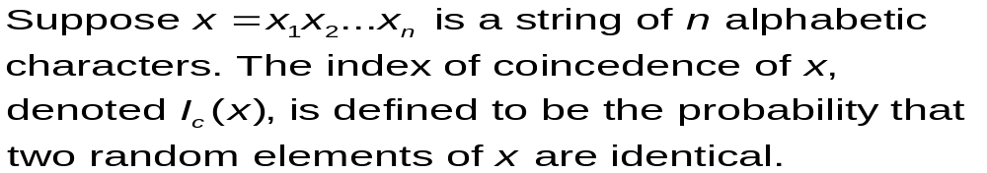


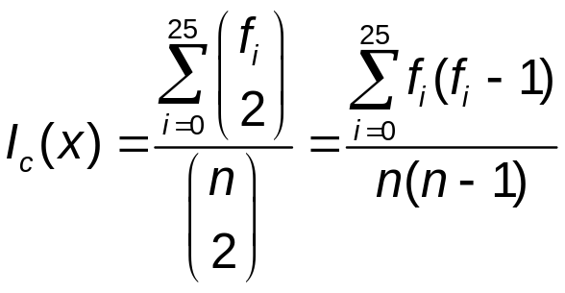
Index of Coincidence
Now we will use the index of coincidence to see if it gives the same result.
The index of coincidence is defined as follows:
If we denote the frequencies of A, B, C, …, Z in x by f₁, f₂, f₃, …, f₂₅. We can choose two elements of x in ways. There are ways of choosing two same elements. Hence, we have the formula

Slide 11
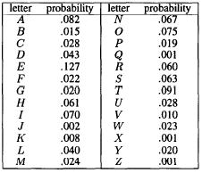
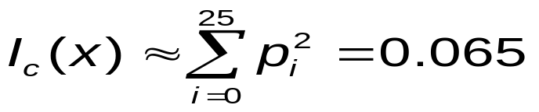
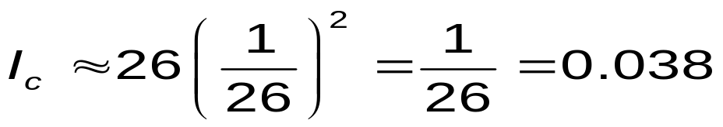
Index of Coincidence
Index of coincidence of a string written in English is approximately equal to 0.065.
Every language has such an IC, for example:
  Russian: 0.0529
  German: 0.0762
  Spanish: 0.0775
Index of coincidence of a random string in English is approximately equal to
Table 1

Slide 12
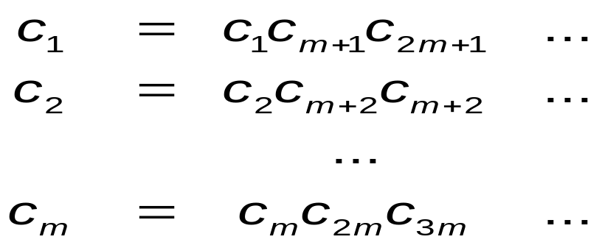
Index of Coincidence
Now we rewrite the ciphertext c in the following way
If c₁, c₂, …, c_{m} are constructed in such a way that m is the keyword length, then each I_{c}(c_{i}) should be approximately equal to 0.065
Following table contains Ic for different values of m:
m | I_{c}
1 | 0.043
2 | 0.052; 0.051
3 | 0.05; 0.059; 0.045
4 | 0.049; 0.053; 0.052; 0.051
5 | 0.034; 0.05; 0.048; 0.038; 0.045
6 | 0.063; 0.07; 0.083; 0.062; 0.071; 0.048
7 | 0.033; 0.041; 0.038; 0.046; 0.041; 0.04; 0.047
.
This method also shows that m = 6

Slide 13
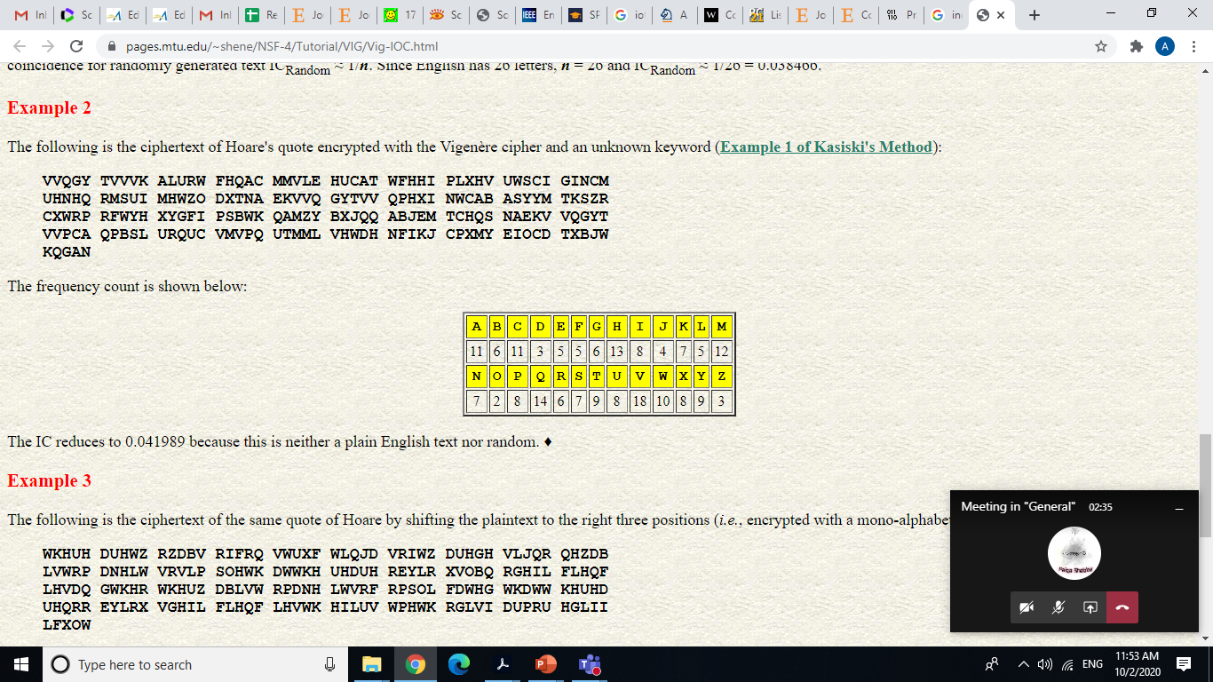

Example to calculate IoC

Slide 14
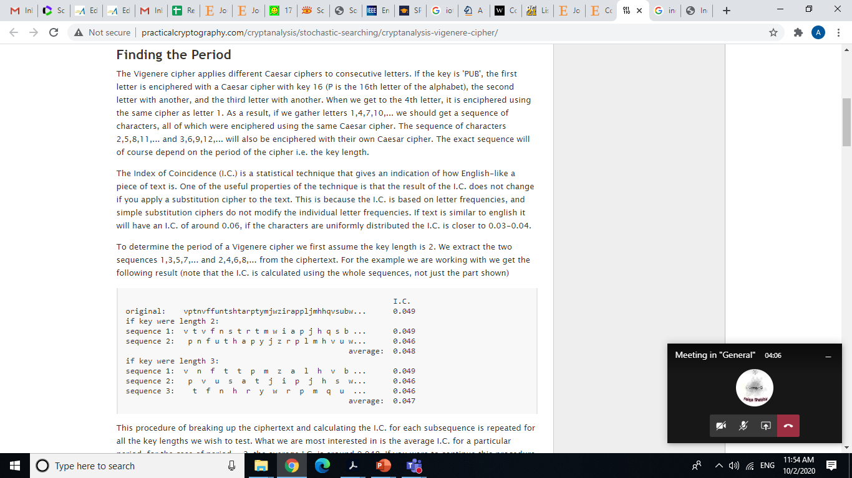

Slide 15
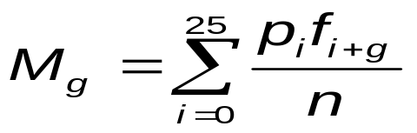
Cryptanalysis of the Vigenère Cipher
Determine the Key Word
To determine the keyword itself we use a method similar to the index of coincidence.
Each substring c_{i} was produced using a monoalphabetic cipher. Thus defining a shift g we can use the following formula
where f₁, f₂, …, f_{i} denotes the frequencies of A, B, …, Z in the substring c_{i}, and n is the length of the substring.
If g is the correct shift value, M_{g} would be roughly equal to 0.065
Now we have to determine the most suitable value of M_{g} for each of the substrings.
For values of pi, consult Table 1

Slide 17
Cryptanalysis of the Vigenère Cipher
i | M_{g}
1 | 0.062; 0.042; 0.033; 0.035; 0.041; 0.039; 0.030; 0.040; 0.036; 0.039; 0.026; 0.040; 0.043; 0.046; 0.038; 0.046; 0.032; 0.033; 0.042; 0.043; 0.037; 0.029; 0.047; 0.035; 0.032; 0.036
2 | 0.033; 0.037; 0.035; 0.035; 0.046; 0.042; 0.048; 0.040; 0.032; 0.028; 0.043; 0.040; 0.038; 0.046; 0.037; 0.026; 0.042; 0.065; 0.037; 0.033; 0.041; 0.044; 0.029; 0.036; 0.038; 0.034
3 | 0.038; 0.030; 0.038; 0.029; 0.043; 0.041; 0.052; 0.034; 0.041; 0.041; 0.036; 0.033; 0.040; 0.040; 0.028; 0.050; 0.031; 0.025; 0.036; 0.073; 0.039; 0.035; 0.034; 0.044; 0.033; 0.038
4 | 0.040; 0.043; 0.034; 0.047; 0.038; 0.031; 0.042; 0.064; 0.037; 0.027; 0.030; 0.042; 0.036; 0.036; 0.038; 0.039; 0.043; 0.041; 0.040; 0.034; 0.044; 0.042; 0.040; 0.033; 0.027; 0.034
5 | 0.030; 0.037; 0.034; 0.030; 0.046; 0.047; 0.041; 0.036; 0.035; 0.043; 0.047; 0.035; 0.038; 0.035; 0.033; 0.036; 0.049; 0.034; 0.027; 0.044; 0.065; 0.037; 0.026; 0.044; 0.045; 0.028
6 | 0.031; 0.039; 0.041; 0.041; 0.038; 0.044; 0.044; 0.034; 0.030; 0.037; 0.039; 0.036; 0.035; 0.039; 0.034; 0.034; 0.042; 0.059; 0.043; 0.029; 0.036; 0.043; 0.037; 0.033; 0.039; 0.035
We have found the keyword, which is ARTHUR.

Slide 18
Cryptanalysis of the Vigenère Cipher
The recovered plaintext message (with spaces added) is:
many traces we found of him in the boggirt island where he had hid his savage ally a huge driving wheel and a shaft half filled with rubbish showed the position of an abandoned mine beside it were the crumbling remains of the cottages of the miners driven away no doubt by the foul reek of the surrounding swamp in one of these a staple and chain with a quantity of gnawed bones showed where the animal had been confined a skeleton with a tangle of brown hair adhering to it lay among the debris.
(Taken from Hound of the Baskervilles, by Arthur Conan Doyle)

Slide 19
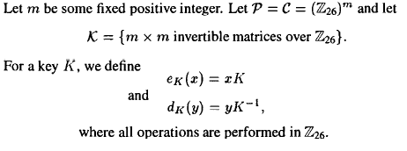
The Hill Cipher
As well as Vigenère, this cipher is polyalphabetic.
It was invented by Lester S. Hill in 1929.

Slide 20
The Hill Cipher
To encrypt a message using the Hill Cipher one should perform the following sequence of steps:
  Using the Table (below), plaintext message has to be expressed as sequence of integers in such a way that p = (p₁, …, p_{m})
  The key is an m×m matrix
  The resulting ciphertext c = e_{k}(p) = p×k will be a string (c₁, …, c_{m}) of length m
To decrypt the ciphertext one should apply the inverse linear transformation. In other words
p = c× k⁻¹, where k k⁻¹ mod 26 = I.
A B C D E F G H I J K L M N 0 P Q R S T U V W X Y Z
0 1 2 3 4 5 6 7 8 9 10 11 12 13 14 15 16 17 18 19 20 21 22 23 24 25

Slide 21
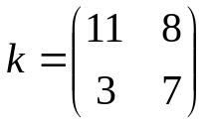
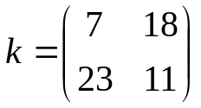
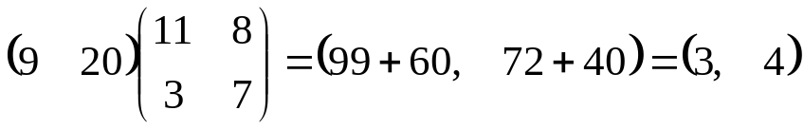
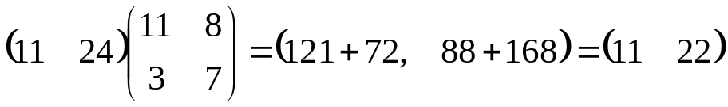
The Hill Cipher
Example:
Encrypting a message using the Hill Cipher is very simple. Decryption however is more challenging.
Suppose the key (K) is
We can compute K⁻¹, which is,
We are given the following plaintext “july”, we need to encrypt two pieces of plaintext ju (9,20) and ly (11,24):
Hence the encryption of july is DELW
After k-1 is found, it is easy to find the corresponding plaintext, which is “matrix” in our case.
and

Slide 22
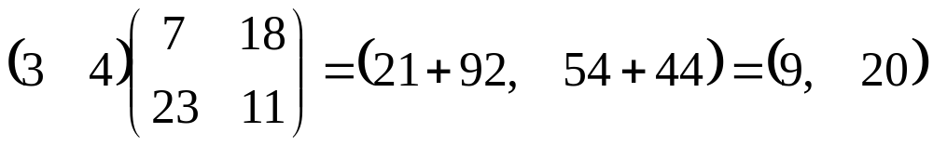
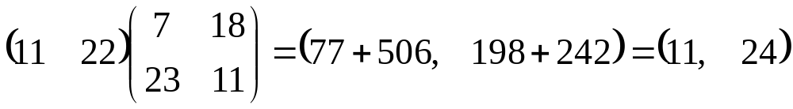
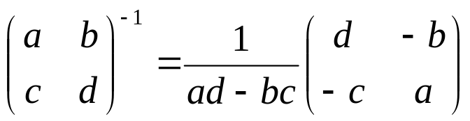
The Hill Cipher
Example:
To decrypt, we use K⁻¹, following computation are made:
Hence the correct plaintext is obtained
In order to decrypt, it is needed the determinant of K to satisfy:
gcd( det(K), 26) =1=(53, 26)
To calculate inverse, the usual formula is:
and

Slide 23
Cryptanalysis of the Hill Cipher
The Hill Cipher is difficult to break using only ciphertex but it can be easily broken using known plaintext attack
Suppose we possess m distinct plaintext-ciphertext pairs p_{j} = (p_{1,j} , p_{2,j} , …, p_{m,j}) and c_{j} = (c_{1,j}, c_{2,j}, …, c_{m,j}), where m is the key dimension. Let us define two m×m matrices X = (c_{i,j}) and Y = (p_{i,j}). Then Y = X k.
Now it is easy to find the key, k = X⁻¹Y,
where X X⁻¹ mod 26 = I.

Slide 24
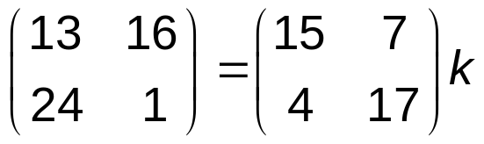
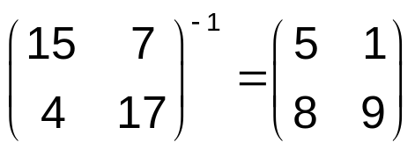
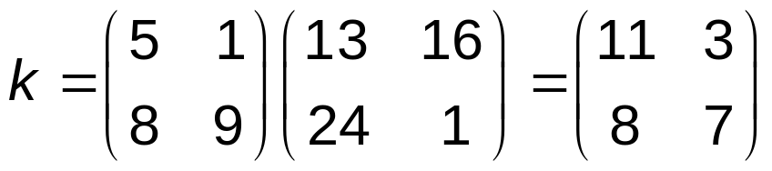
Cryptanalysis of the Hill Cipher
Assume we have ciphertext “IKNQYB” and we know that the plaintext is “cipher”.
Assume m = 2. e_{k}(2, 8) = (8, 10), e_{k}(15, 7) = (13, 16), and e_{k} (4, 17) = (24, 1). Using the second and the third plaintext-ciphertext pairs, we come up with the following equation in the form Y = X k
To find the key, we need inverse modulo of X
Now

Slide 25
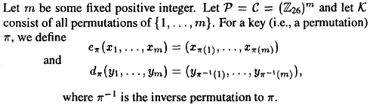
The Permutation Cipher
This cryptosystem is really old.
It was described in book by Giovanni Porta written in 1563.
“Rail-fence” cipher is an example of permutation cipher.

Slide 26
The Permutation Cipher
In order to use the cipher a permutation has to be defined. Let us use the following permutation as example:
Since m = 6, the original message has to be broken on n groups of six letters each. If last group is shorter, necessary number of dummy letters can be appended to the end.
Each group is rearranged according to the permutation defined previously.
To decrypt a ciphertext message inverse permutation should be applied in a similar way.
x | 1 | 2 | 3 | 4 | 5 | 6
π(x) | 5 | 1 | 6 | 3 | 2 | 4
c | 1 | 2 | 3 | 4 | 5 | 6
π⁻¹(c) | 2 | 5 | 4 | 6 | 1 | 3

Slide 27
The Permutation Cipher
Suppose m=6, and the key is the following permutation π:
x | 1 | 2 | 3 | 4 | 5 | 6
π(x) | 3 | 5 | 1 | 6 | 4 | 2
Now suppose we are given the plaintext:
shesellsseashellsbytheseashore
We first partition it into a group of 6:
shesel lsseas hellsb ythese ashore
Now each group of 6 letters is rearranged according to the permutation table π:
EESLSH SALSES LSHBLE HSYEET HRAEOS
This is ciphertext, which can be decrypted in a similar fashion using inversion permutation π⁻¹
x | 1 | 2 | 3 | 4 | 5 | 6
Π⁻¹(x) | 3 | 6 | 1 | 5 | 2 | 4

